Slide 1



END SEMESTER
PROJECT
Junuary 2025
f.hassani@enscs.edu.dz
s.harnane@enscs.edu.dz
m.kassoul@enscs.edu.dz
a.gheribi@enscs.edu.dz

Slide 2

CONTENT
01
Introduction
02
DSR
03
Route Discovery
04
Route Maintenance
05
DSR Algorithm
06
Advantages and Limitations

Slide 3
CONTENT
07
Comparison with Other Protocols
08
Summing up
09
Simulation

Slide 4
01
Introduction

Slide 5
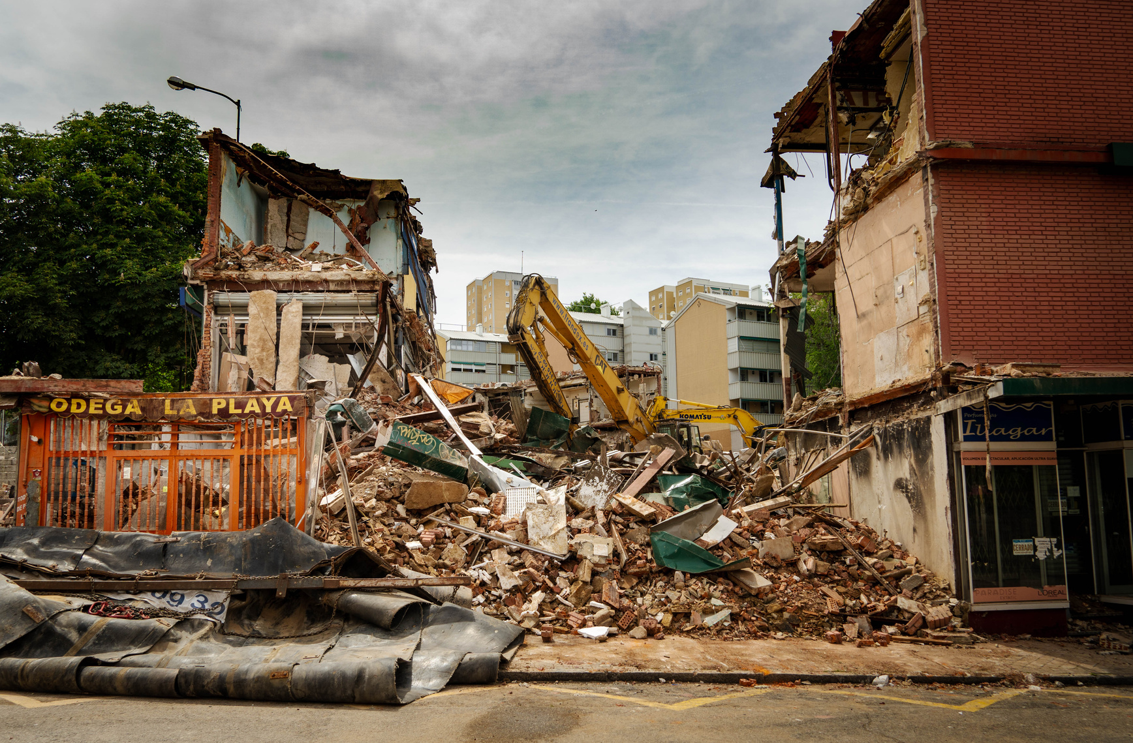
INTRODUCTION
Imagine a city hit by a massive earthquake. Communication lines are down, power is out, and traditional networks are unusable. How can rescue teams coordinate their efforts and share critical information in such chaos?

Slide 6

INTRODUCTION
Now, think of a military unit deployed in a remote region, far from any cellular coverage. How do they maintain secure and reliable communication while on the move?

Slide 7

INTRODUCTION
Or picture a large outdoor festival in a remote area, where thousands of attendees need to stay connected, but the existing infrastructure is overwhelmed. What alternative can handle this demand?

Slide 8

INTRODUCTION
In situations like these, a unique type of network steps in, solving problems traditional systems cannot.
Mobile Ad Hoc Networks (MANETs)

Slide 9

WHAT ARE MOBILE AD HOC NETWORKS (MANETS)?
Definition :
Mobile Ad Hoc Networks (MANETs) are decentralized wireless networks formed dynamically without the need for any fixed infrastructure or centralized administration.
Devices, or nodes, in a MANET can move freely and organize themselves into the network.
Examples :
Disaster Recovery: In natural disasters like earthquakes or floods, MANETs enable communication among rescue teams where traditional infrastructure is unavailable.
Military Operations: Soldiers and vehicles form tactical
networks in remote areas for secure communication.
IoT Communication: Smart devices communicate directly
in applications such as smart homes or industrial automation.

Slide 10
WHAT ARE MOBILE AD HOC NETWORKS (MANETS)?
Characteristics :
Infrastructure-less
No reliance on base stations or centralized control points.
Nodes themselves handle routing and data transmission.
Dynamic Topology
Nodes can join, leave, or move around freely, leading to frequent topology changes.
Decentralized Operations
Each node operates independently, and decisions are distributed across the network.

Slide 11
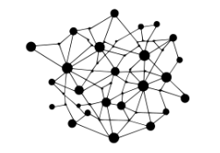
WHAT ARE MOBILE AD HOC NETWORKS (MANETS)?
Challenges :
Frequent Topology Changes
The constant movement of nodes causes routes to break, requiring frequent updates.
Limited Resources
Nodes typically have constraints like limited battery power, memory, and processing capacity.
Energy Constraints
Efficient routing is critical as nodes often run on
limited energy sources.

Slide 12
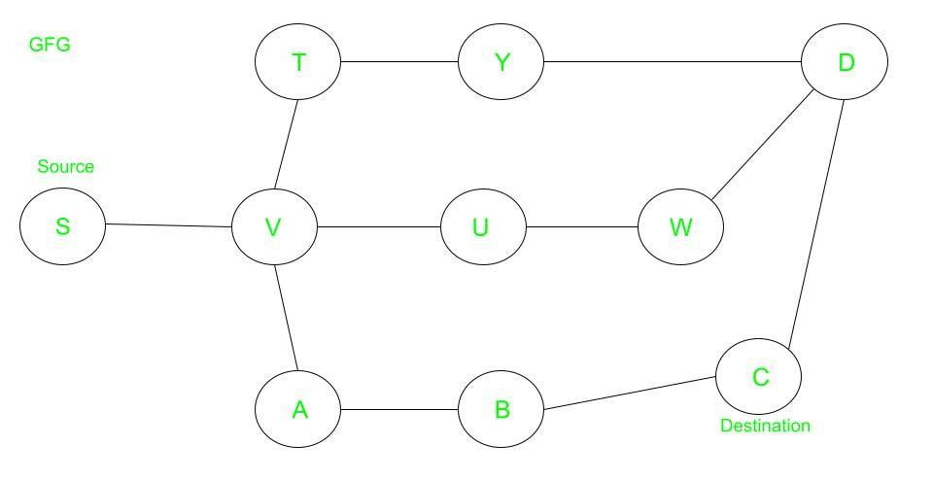
NEED FOR ROUTING IN MANETS
Routing protocols are essential to ensure data packets are delivered efficiently despite these challenges.
DSR AS A SOLUTION

Slide 13
02
DSR

Slide 14
INTRODUCTION TO DSR
Dynamic Source Routing (DSR) is an on-demand source routing protocol designed specifically for MANETs.
What do we mean by :
On-demand
Source routing

Slide 15
KEY FEATURES OF DSR
On-Demand Routing
What It Means:
Routes are established only when there is data to send.
Eliminates the need for periodic updates, unlike proactive protocols.
Why It’s Useful:
Saves bandwidth and energy by avoiding unnecessary communication.
Ideal for dynamic networks where nodes frequently join, leave, or move.

Slide 16
KEY FEATURES OF DSR
Source Routing
What It Means:
The source node determines the full path to the destination and includes this path in the header of each packet.
Intermediate nodes forward the packet based on the included path, without needing to maintain their own routing tables.
Advantages:
Simplifies intermediate node operations (no routing tables).
Makes route tracing and debugging easier.
Limitations:
Adds overhead to packets in large networks due to long headers.

Slide 17
KEY FEATURES OF DSR
Self-Configuring
What It Means:
DSR adapts dynamically to changes in the network topology.
Nodes automatically adjust to route breaks and establish new paths without manual intervention.
Why It’s Crucial:
Ensures reliability in networks where node mobility leads to frequent changes in connectivity.

Slide 18


HOW IT WORKS ?
ROUTE DISCOVERY
ROUTE MANAGEMENT

Slide 19
03
Route Discovery

Slide 20

ROUTE DISCOVERY
Objective
Finding a Route to the Destination:
The main goal of the route discovery process in DSR is to identify a valid path from the source node to the destination node.
This process is initiated only when the source node needs to send data and does not already have a route to the destination in its route cache.

Slide 21
PROCESS
1. Route Request (RREQ)
Sent by the Source Node:
The source node broadcasts a Route Request (RREQ) packet to all its neighbors to discover a route to the destination.
The RREQ contains:
Source node address.
Destination node address.
A unique identifier (to avoid processing duplicate RREQs).
A list of addresses representing the route accumulated so far.

Slide 22
PROCESS
1. Route Request (RREQ)
Broadcast Nature with Route Accumulation:
As the RREQ propagates through the network:
Each intermediate node appends its own address to the route field in the RREQ.
The packet is forwarded further until it either reaches the destination or an intermediate node with a cached route to the destination.
To avoid redundancy, nodes drop duplicate RREQs received earlier.

Slide 23
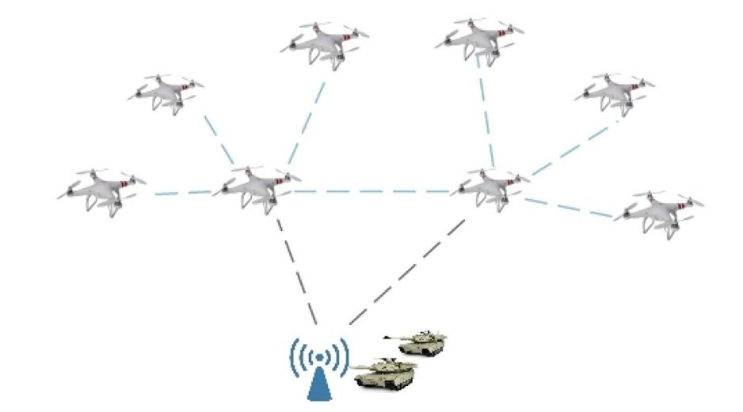

Slide 24
G
B
D
J
H
A
E
I
C
F

Slide 25
G
B
D
I don’ t know the route to J
J
H
A
E
I
C
F

Slide 26
G
B
D
Maybe my neighbout know
J
H
A
E
I
C
F

Slide 27
G
B
D
I am gonna generate a RREQ message
J
H
A
E
I
C
F

Slide 28
G
B
D
J
H
3 | | A | J
A
E
I
C
F

Slide 29
G
B
D
PATH
SOURCE
J
H
ID
DESTINATION
A
E
3 | | A | J
I
C
F

Slide 30
G
B
D
J
H
3 | | A | J
A
E
I
C
F

Slide 31
G
B
D
NOW ...
I broadcast !!!
J
H
3 | | A | J
A
E
I
C
F

Slide 32
3 | B | A | J
G
B
D
J
H
A
E
I
C
F
3 | C | A | J

Slide 33
I don’ t know the route to J
3 | B | A | J
G
B
D
J
H
A
E
I
C
F
I don’ t know the route to J
3 | C | A | J

Slide 34
Maybe my neighbout know
3 | B | A | J
G
B
D
J
H
A
E
I
C
F
3 | C | A | J
Maybe my neighbout know

Slide 35
3 | B | A | J
G
B
D
J
H
3 | B | A | J
A
E
3 | C | A | J
3 | C | A | J
I
C
F

Slide 36
3 | B,D | A | J
G
B
D
J
H
3 | B | A | J
A
E
3 | C | A | J
3 | C | A | J
I
C
F

Slide 37
3 | B,D | A | J
G
B
D
I broadcasted this message !
J
H
3 | B | A | J
A
E
3 | C | A | J
3 | C | A | J
I
C
F

Slide 38
3 | B,D | A | J
G
B
D
J
Drop it !
H
3 | B | A | J
A
E
3 | C | A | J
3 | C | A | J
I
C
F

Slide 39
3 | B,D | A | J
G
B
D
J
H
A
E
3 | C | A | J
I
C
F

Slide 40
3 | B, D , G | A | J
D
G
B
J
H
A
E
3 | C , E | A | J
I
C
F

Slide 41
D
G
I recived two RREQ with the same information !
B
J
3 | B, D , G | A | J
H
3 | C , E | A | J
A
E
I
C
F
3 | C , E | A | J

Slide 42
D
G
I drop the longest ones and I keep the smallest one !
B
J
H
3 | C , E , H | A | J
A
E
I
C
F
3 | C , E , F | A | J

Slide 43
D
G
B
J
H
3 | C , E , H | A | J
A
E
I
C
F
3 | C , E , F, I | A | J

Slide 44
I recived two RREQ with the same information !
D
G
B
J
H
3 | C , E , H | A | J
3 | C , E , F, I | A | J
A
E
I
C
F

Slide 45
I drop the longest ones and I keep the smallest one !
D
G
B
J
H
3 | C , E , H | A | J
A
E
I
C
F

Slide 46
PROCESS
Route Reply (RREP)
Sent by the Destination (or Intermediate Node with Cached Route):
When the RREQ reaches the destination, the destination node sends a Route Reply (RREP) back to the source using the accumulated route in the RREQ.
If an intermediate node has a cached route to the destination, it can respond with an RREP instead of forwarding the RREQ further.

Slide 47
PROCESS
Route Reply (RREP)
Unicast Nature:
The RREP is sent unicast (directly) along the reverse of the route accumulated in the RREQ.
Intermediate nodes don’t need to modify the RREP, as the route is already known.

Slide 48
D
G
B
J
H
3 | C , E , H | A | J
A
E
I
C
F

Slide 49
You found me A !
take the path to get me
D
G
B
J
H
3 | C , E , H | A | J
A
E
I
C
F

Slide 50
I am gonna send a
RREP message !
D
G
B
J
H
3 | C , E , H | A | J
A
E
I
C
F

Slide 51
D
G
B
J
H
3 | C , E , H | A | J
A
E
I
C
F

Slide 52
D
G
B
J
H
3 | C , E , H | A | J
A
E
I
C
F

Slide 53
D
G
B
J
H
A
E
3 | C , E , H | A | J
I
C
F

Slide 54
D
G
B
J
H
A
E
I
C
F
3 | C , E , H | A | J

Slide 55
D
G
B
J
H
A
E
3 | C , E , H | A | J
I
C
F

Slide 56
D
G
B
That’s what I am talking about !
J
H
A
E
3 | C , E , H | A | J
I
C
F

Slide 57
D
G
B
Now I use this path as a header
J
H
A
E
3 | C , E , H | A | J
I
C
F

Slide 58
D
G
B
Now I use this path as a header
J
H
A
E
DATA
3 | C , E , H | A | J
I
C
F

Slide 59
D
G
B
I store it in my table also ...
Maybe I need it later
J
H
A
E
DATA
3 | C , E , H | A | J
I
C
F

Slide 60
D
G
B
J
H
A
E
I
C
F
DATA
3 | E , H | A | J

Slide 61
D
G
B
J
H
A
E
DATA
3 | H | A | J
I
C
F

Slide 62
D
G
B
J
H
A
DATA
E
3 | | A | J
I
C
F

Slide 63
D
G
B
J
H
DATA
3 | | A | J
A
E
I
C
F

Slide 64
04
Route Maintenance

Slide 65
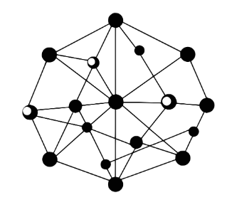

ROUTE Maintenance
Objective
Ensuring Valid Routes:
The goal of route maintenance in DSR is to ensure that routes remain valid and usable as nodes move or links break.
This involves detecting and addressing broken links quickly to maintain seamless communication.

Slide 66
PROCESS
Monitoring Link Status
How Nodes Monitor Links:
Nodes continuously monitor the status of their links with neighbors.
This monitoring can be achieved through:
Acknowledgements: A node expects an acknowledgment from the next hop after sending a packet.
Periodic HELLO Messages: Some nodes periodically send small messages to confirm link connectivity.
Detecting Failures:
If a node does not receive an acknowledgment or detect a HELLO message, it concludes that the link to its neighbor has failed.

Slide 67
PROCESS
Route Error (RERR)
When RERR is Generated:
If a node detects a link failure, it creates a Route Error (RERR) message to notify the source node about the broken route.
How RERR Works:
The RERR is sent back along the reverse path to the source node.
Each intermediate node receiving the RERR removes the invalid route from its route cache.
Triggering New Route Discovery:
When the source node receives the RERR, it either:
Uses an alternative cached route to the destination.
Initiates a new route discovery process if no alternative route is available.

Slide 68
G
B
D
J
H
A
E
I
C
F

Slide 69
G
B
D
J
H
A
E
I
C
F

Slide 70
G
Oups !
I can’t reach J any more
B
D
J
H
A
E
I
C
F

Slide 71
G
Everyone
have to know that !
B
D
J
H
A
E
I
C
F

Slide 72
G
I am gonna send a RERR
message
B
D
J
H
A
E
I
C
F

Slide 73
G
B
D
J
H
A
E
H - J
I
C
F

Slide 74
G
B
D
H - J
J
H
A
E
H - J
H - J
I
C
F

Slide 75
G
B
D
H - J
J
H
H - J
A
E
I
C
F
H - J
H - J

Slide 76
G
B
D
H - J
I know so I drop it
J
H
H - J
A
E
H - J
I
C
F
H - J

Slide 77
G
B
D
H - J
J
H
H - J
A
E
I
C
F
H - J

Slide 78
G
B
D
I lost my path into J . So I have to edit my cache
J
H
A
E
H - J
I
C
F

Slide 79
G
B
D
OH !
Here we go again !
J
H
A
E
I
C
F

Slide 80
05
DSR
Algorithm

Slide 81
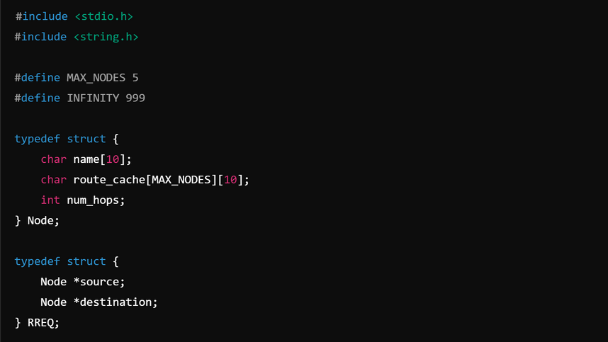
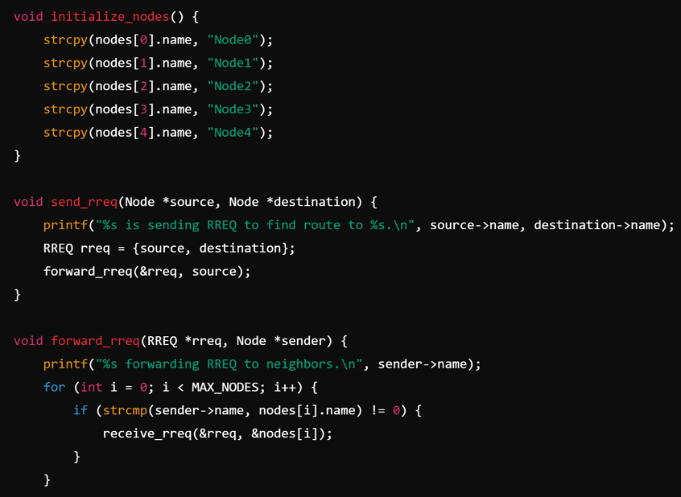
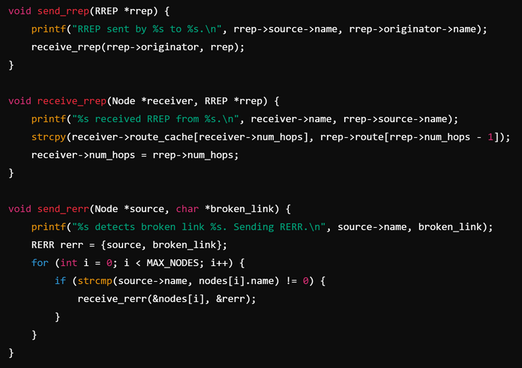
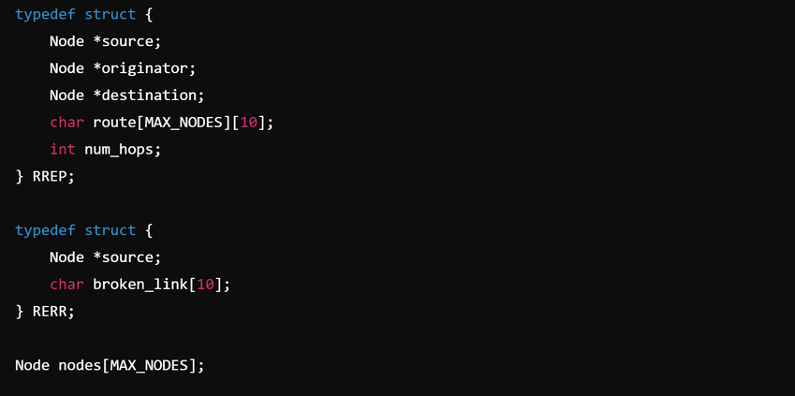
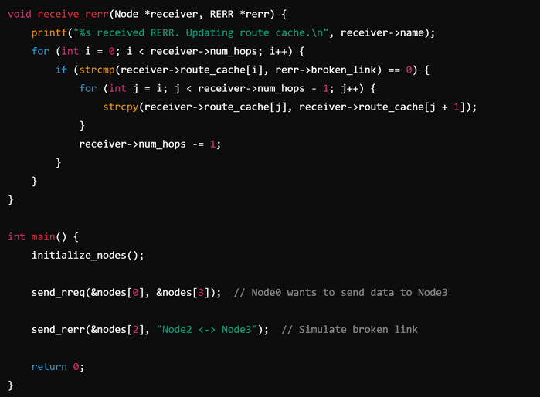
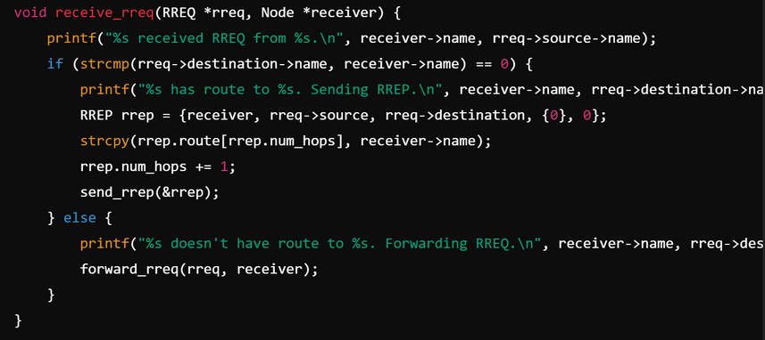
CODE IN C

Slide 82
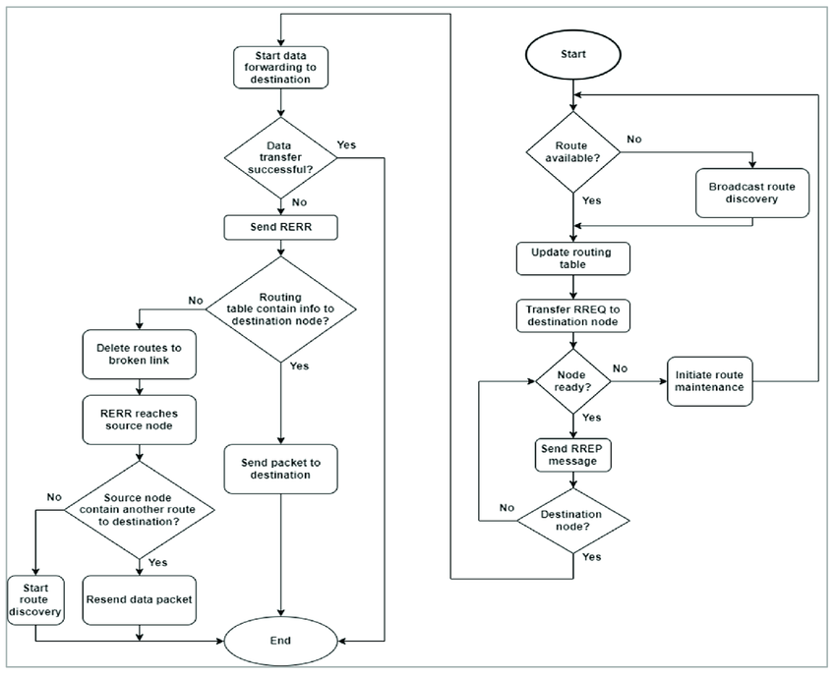
SIMPLE ILLUSTRATION

Slide 83
06
Advantages and Limitations

Slide 84
ADVANTAGES
1 .Efficient in Dynamic Environments:
DSR excels in Mobile Ad hoc Networks (MANETs) due to its ability to adapt to changes in topology quickly without relying on pre-established routing tables.
2. Reduces Routing Overhead:
Unlike proactive protocols, which maintain routing tables constantly, DSR only establishes routes when needed, leading to lower bandwidth usage and reduced routing overhead.
3. Simplifies Protocol Design with Source Routing:
By allowing the source node to determine the complete route to the destination, DSR eliminates the need for routing tables at intermediate nodes, simplifying protocol design and implementation.

Slide 85
LIMITATIONS
1. Header Overhead in Large Networks:
Since DSR uses source routing, each packet carries its entire route in the header. This increases the size of packet headers, especially in large networks, leading to inefficient use of bandwidth.
2. Potential for Route Cache Staleness:
As DSR relies on caching routes at nodes, stale or outdated routes can lead to route errors, which can slow down communication in the network.
3. Flooding During Route Discovery in Large Networks:
In scenarios where route discovery needs to be initiated, DSR might experience excessive flooding, increasing the risk of collisions and delays, which is less efficient in larger networks.

Slide 86
07
Comparison with Other Protocols

Slide 87
DSR VS AODV
Source Routing vs. Hop-by-Hop Routing:
DSR uses source routing, where the entire route to the destination is included in the packet header, whereas AODV uses hop-by-hop routing, where intermediate nodes rely on a route table to forward packets.
Differences in Routing Table Maintenance:
DSR caches routes at intermediate nodes and the source, while AODV
maintains routing tables by sending periodic control messages. AODV
dynamically updates these tables using route request and reply
mechanisms.

Slide 88
08
Summing Up

Slide 89
SUMMING UP
To sum up , the Dynamic Source Routing (DSR) protocol, a key solution for efficient and reliable routing in ad hoc networks. We discussed how DSR operates through two main processes: Route Discovery and Route Maintenance, enabling devices to communicate dynamically without relying on fixed infrastructure.
We highlighted its strengths, including adaptability to changing network topologies and reduced overhead, as well as its challenges, such as handling high mobility scenarios and scalability issues.

Slide 90

SUM UP
However, everything we've seen so far has been theoretical.
Now, it's time to bring it to life through a simulation
allowing us to observe how DSR performs in real-world scenarios.

Slide 91
09
Simulation

Slide 92
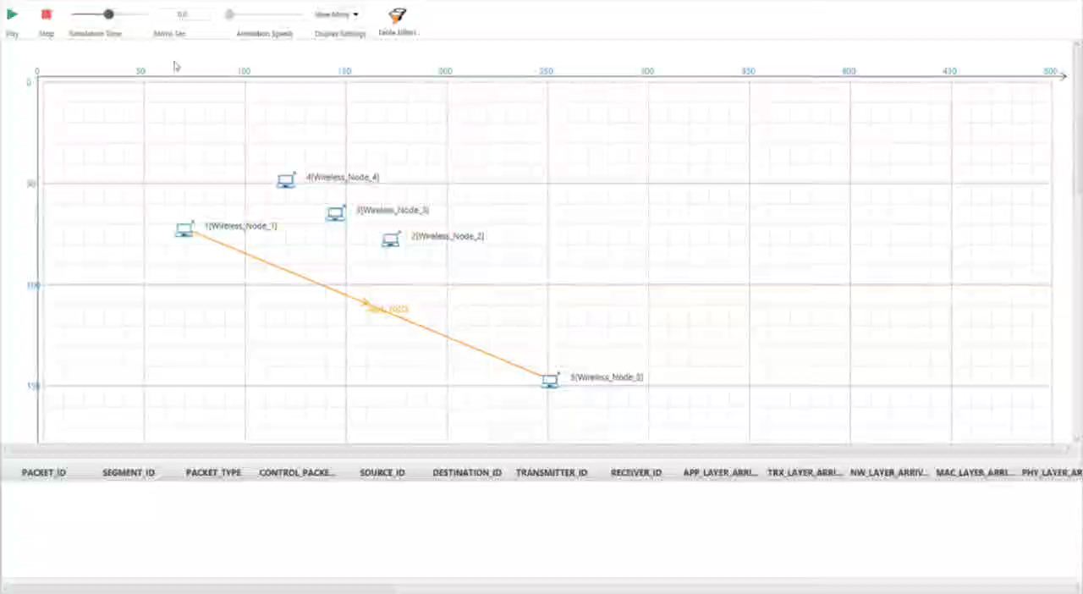

Slide 93

THANK YOU
FOR YOUR ATTENTION
Join us !
f.hassani@enscs.edu.dz
s.harnane@enscs.edu.dz
m.kassoul@enscs.edu.dz
a.gheribi@enscs.edu.dz

